Slide 1
HW 3 – Scene Graph Animation

Slide 2
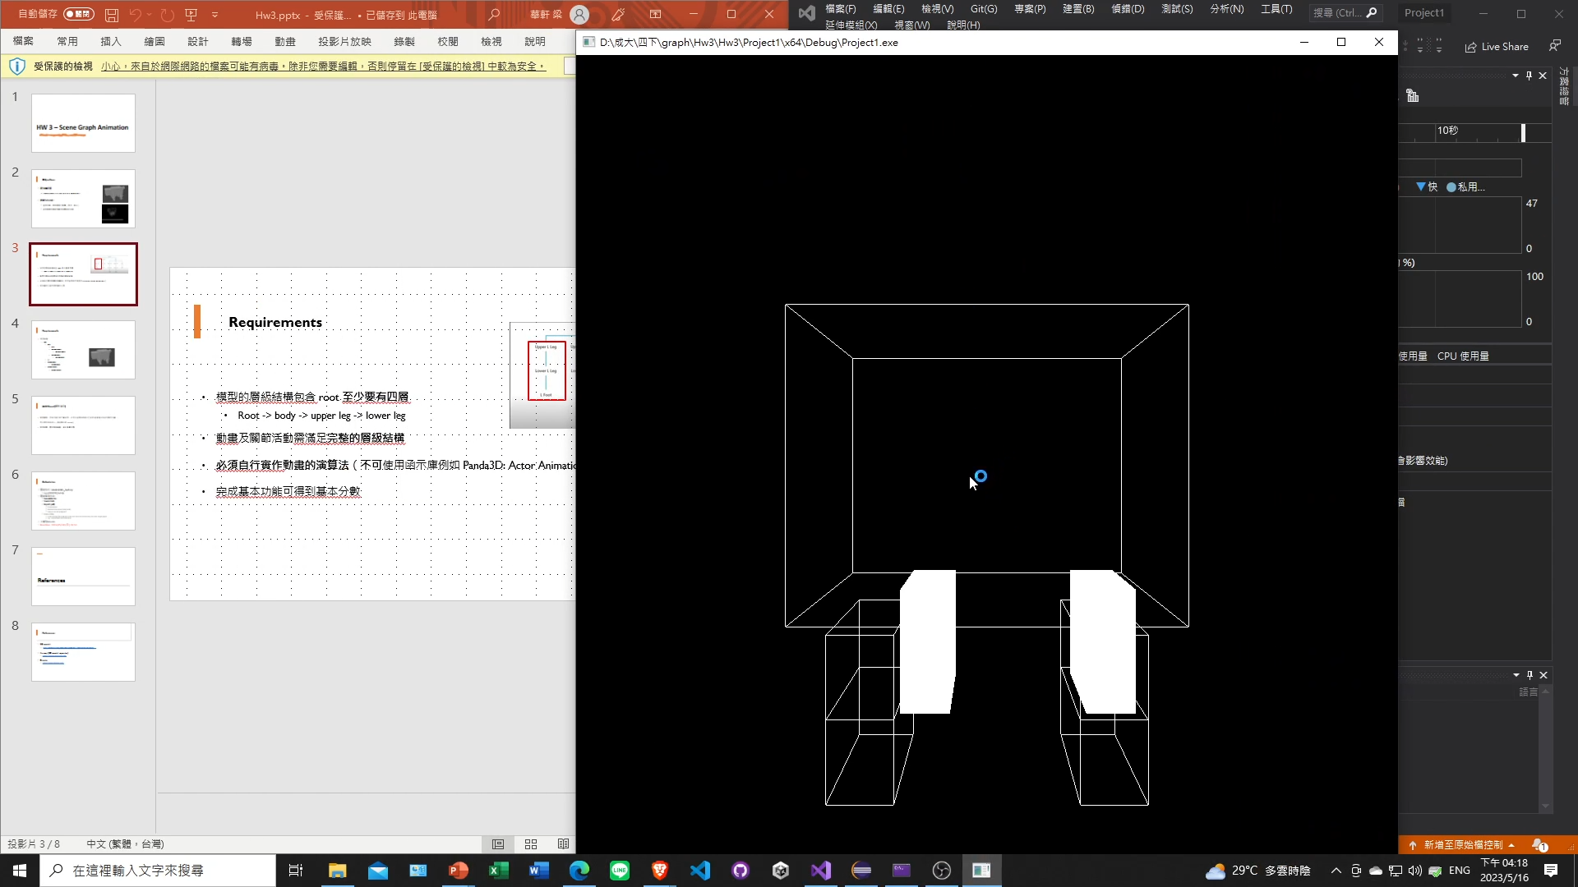
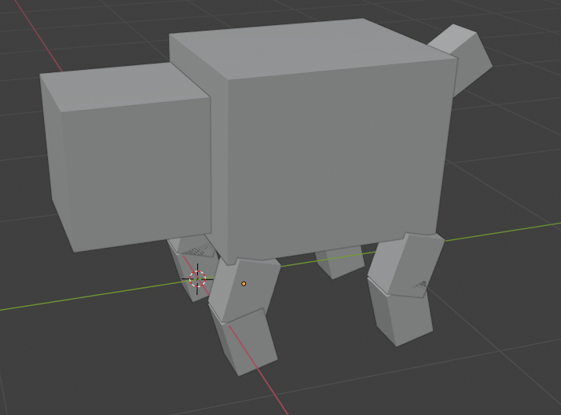
Objectives
Implement 3D animation using scene graph architecture and multiple basic components.

Slide 3
Basic Requirements
You can use the model:
In the attachment.
Made by yourself.
Download the model from the internet.
The depth of the architecture MUST have at least 3 levels.
The animation and the joints MUST satisfy the architecture.
You MUST implement the animation by yourself. Do not use the library function, e.g., Panda3D: Actor Animations to directly load the animation from file.
Record your result from the start and remember to also include any additional features to get extra points. Scoring heavily depends on the demo video, so please double-check it before uploading.

Slide 4
Additional
You will receive additional scores if you successfully implement and demo the following features.
Using texture. (e.g., hw1 teapot’s texture)
Camera rotation and translation.
Moving around. (e.g., running in circles)

Slide 5
Submission
Compress your file into <student ID>_<student name>.zip, e.g., p76114074_張浩綸.zip
The zip file needs to include:
Source Code and Model Files (if any)
Report (.pdf), including: (1) Environment, (2) Method description and (3) How to run the program
Demo Video
Upload to Moodle:
Deadline: 2023/11/27 (Mon.) 23:59

